Slide 1


Project Progress Update
January 10, 2023
Partner Org Rep:
Charlyn
Data Ambassadors:
Alex, Juan, Glenn, Corrina
Notes:
SPEAKER: <name>

Slide 2
Project Goals
Goals Set at DC DataDive (October 2022):
Join data sets based on census block/tract level and generate needs score and visualize in a map
Webscrape data of mental health providers from idealist.org to identify areas in DMV region with few service providers
Analyze/review data of # of participants served with SWT
Define outcome measures and Key Performance Indicators (KPIs) to track over time
Provide recommendations for standardized data collection
Notes:
SPEAKER: <name>

Slide 3
Community Resilience and Equity
Community Resilience Estimates (CRE):
Source: Census Bureau
Analyzes 10 risk factors of individuals and households in a community
Measures the capacity for a community to absorb the external stressors of a disaster
CRE Equity Supplement:
Source: Census Bureau
Supplement to the CRE that aims to provide context through the lens of social vulnerability and equity.
Notes:
Community Resilience Estimates (CRE):
Risk Factors (RF) for Households (HH) and Individuals (I)
• RF 1: Income-to-Poverty Ratio (IPR) < 130 percent (HH).
• RF 2: Single or zero caregiver household - only one or no individuals living in the household who are 18-64 (HH).
• RF 3: Unit-level crowding defined as > 0.75 persons per room (HH)
• RF 4: Communication barrier defined as either
o Limited English-speaking households1 (HH) or
o No one in the household over the age of 16 with a high school diploma (HH)
• RF 5: No one in the household is employed full-time, year-round. The flag is not applied if all residents of the household are aged 65 years or older (HH).
• RF 6: Disability posing constraint to significant life activity
o Persons who report having any one of the six disability types (I): hearing difficulty, vision difficulty, cognitive difficulty, ambulatory
difficulty, self-care difficulty, and independent living difficulty.
• RF 7: No health insurance coverage (I)
• RF 8: Being aged 65 years or older (I)
• RF 9: Households without a vehicle (HH)
• RF 10: Households without broadband Internet access (HH)

Slide 4
Mental Health
Adults Ever Diagnosed with Depression
Source: Centers for Disease Control & Prevention - PLACES
Accessed via D.C. Health Matters
Reports on the percentage of adults living in D.C. who report if they have ever been diagnosed with depression
The lowest value is 15%, and the highest value is 31%. Half of the values are between 19.1% and 21.6%. The middle (median) value is 20.5%
Notes:
SPEAKER: <name>

Slide 5
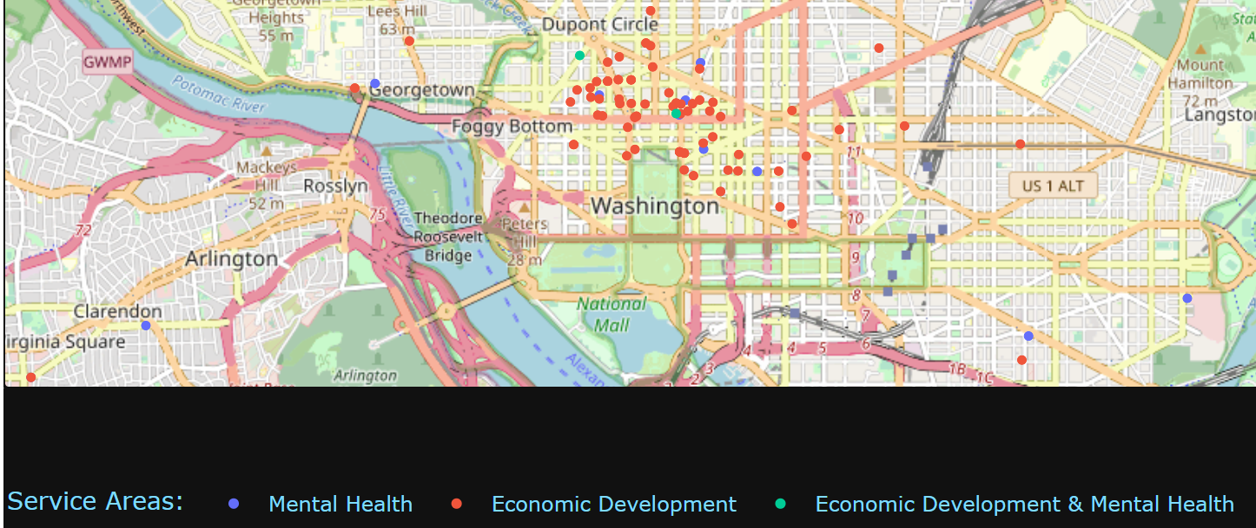
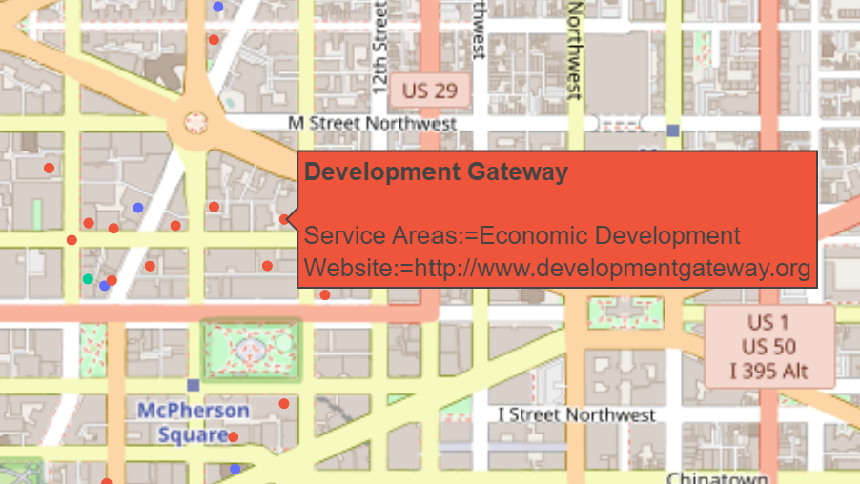
Interactive Dashboard
Interactive map displaying mental health and economic development services
Hovering over each location provides the service and website
SWT Dashboard Link: https://swt-app.herokuapp.com/
Notes:
SPEAKER: <name>

Slide 6
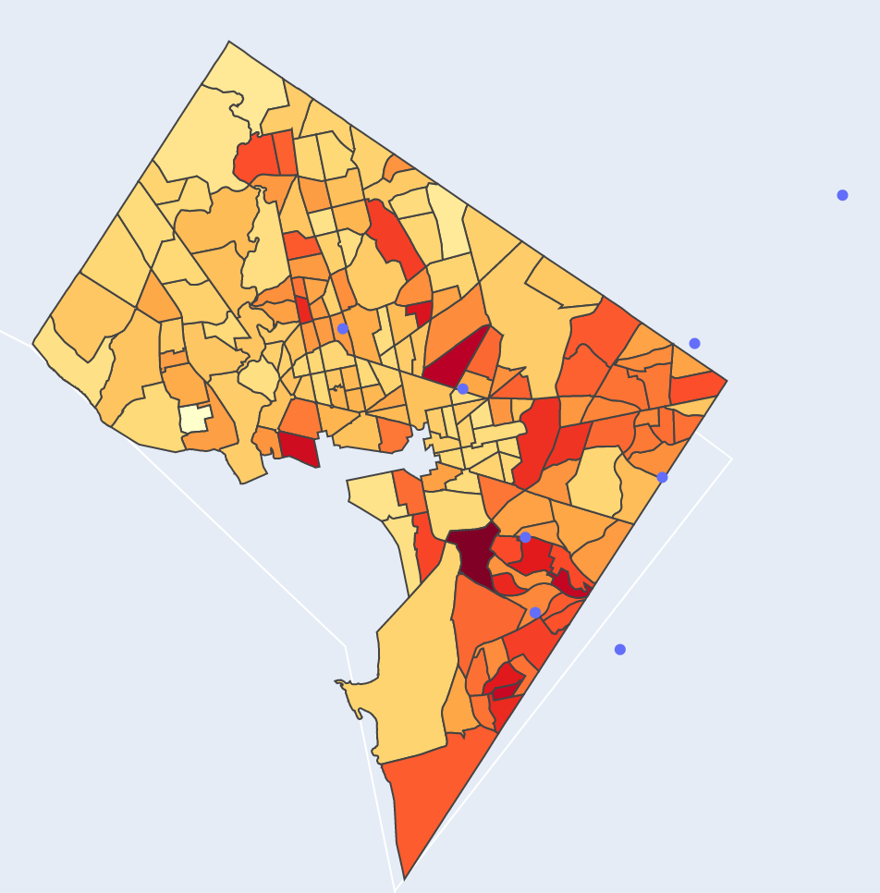
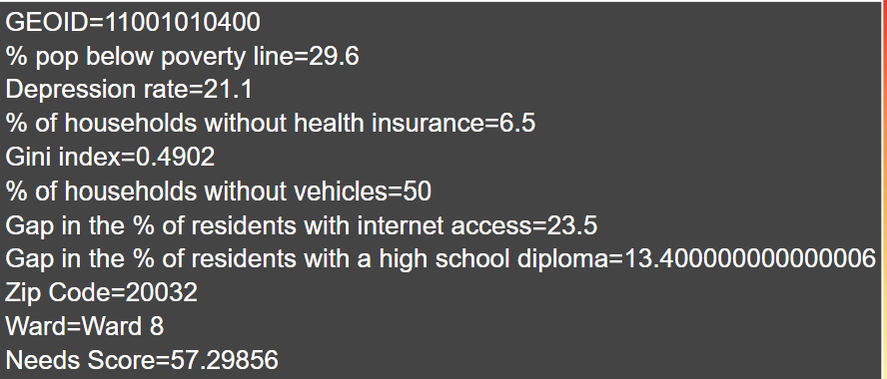
Interactive Dashboard Cont.
Needs Score Heat Map:
Need Score (0-100) by Tract
Dots indicated the location of previous SWT events
Hovering over each Tract provides relevant data points
Needs Score Hierarchy:
Poverty
Health Insurance
Depression Rate
Income Inequality
Education Attainment
Vehicle Access
Internet
SWT Dashboard Link: https://swt-app.herokuapp.com/
Notes:
SPEAKER: <name>

Slide 7
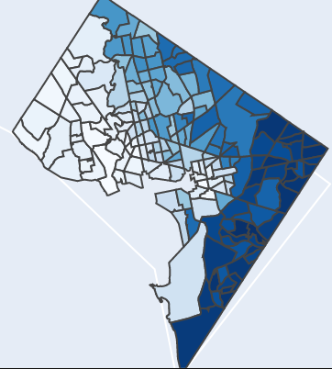
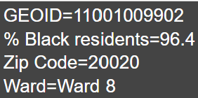
Interactive Dashboard Cont.
Heat Map by Race:
Data for Black residents (current target population)
Hovering over each Tract provides relevant data points
SWT Dashboard Link: https://swt-app.herokuapp.com/
Notes:
SPEAKER: <name>

Slide 8
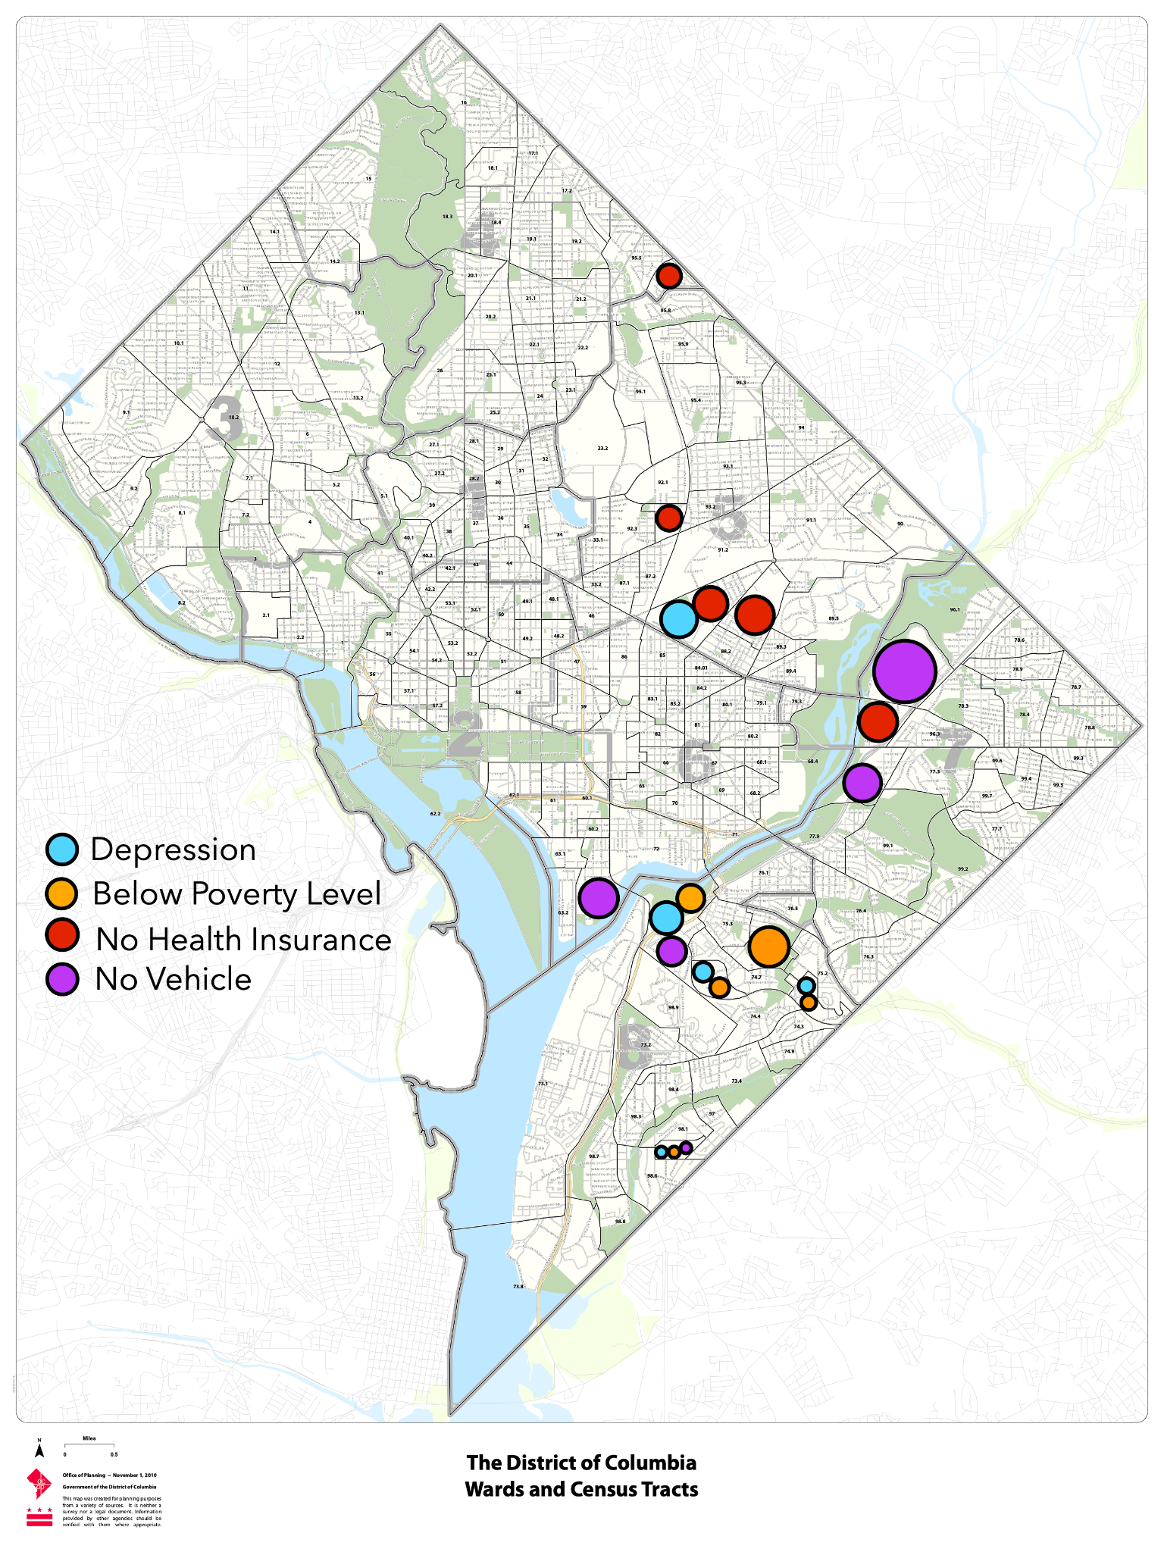
Census Data Analysis
Top 5 Census Tracts for Each Need Indicator
Which areas of need disproportionately affect the Black population?
Need Indicator | Average Rate for All D.C. Census Tracts | Average for Majority Black D.C. Census Tracts
Depression | 20.56% | 20.25% (-0.31%)
Household Income Below Poverty Level | 17.10% | 24.92% (+7.82%)
Household Lacks Health Insurance | 3.83% | 4.82% (+0.99%)
Household has No Vehicle | 34.78% | 37.15% (+2.37%)
Notes:
SPEAKER: <Corrina>
We looked at average rates across all D.C. Census Tracts, and compared that with average rates for D.C. Census Tracts that have a majority Black, Non-Hispanic (> 50%) population.
We are still exploring the CRE supplement data to identify the Census Tracts, Zip Codes, and Wards with the highest level of needs (i.e., percentage of the population without health insurance) to use in a summary of key data points for fundraising efforts

Slide 9
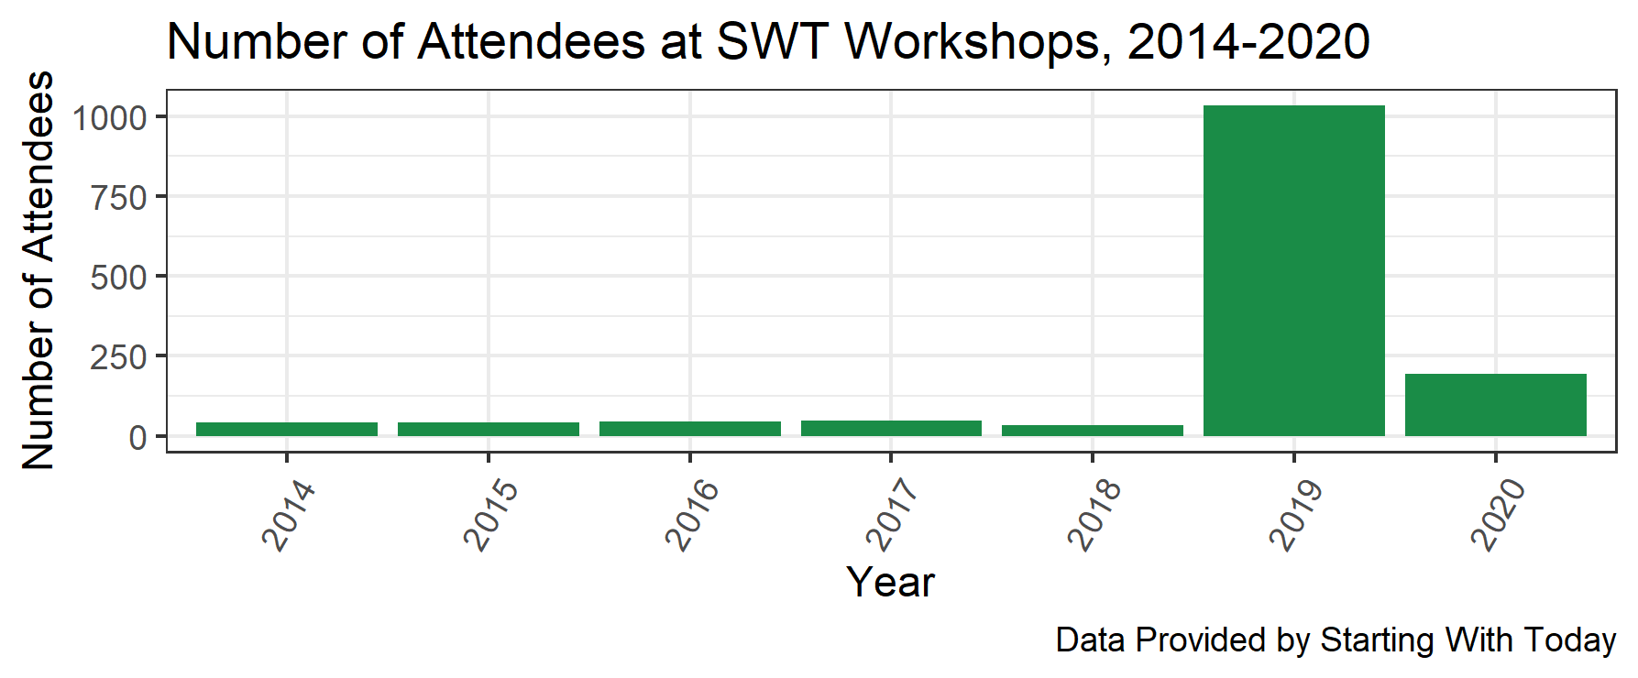
SWT Plot Updates
Notes:
SPEAKER: <name>

Slide 10
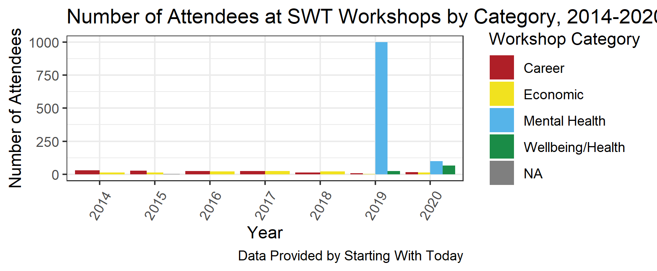
SWT Plot Updates
Notes:
SPEAKER: <name>

Slide 11
Project Limitations
Lack of fidelity in SWT data from online viewership
Increased data maturity is needed to measure outcomes and determine key performance indicators
Unable to obtain mental health data outside of Washington DC
Notes:
SPEAKER: <name>

Slide 12
Next Steps
Continue to refine the interactive dashboard to improve user interface and user experience
Add in Prince George’s county census tracts into heat map
Provide suggestions to improve SWT data collection
Requests from SWT
Notes:
SPEAKER: <name>

Slide 13
Questions?
Partner Org Rep:
Charlyn
Data Ambassadors:
Alex, Juan, Glenn, Corrina
Notes:
SPEAKER: <name>

